Slide 1
Workbook Financing – Net debt
Internal Use Only
April 2017
EXCEL FILE:

Slide 2
Disclaimer
The content of this workbook has been produced by KPMG Germany/Deal Advisory on the basis of German accounting standards and/or IFRS, as well as considering KPMG Germany’s firm and country requirements, regulations, processes, policies and best practices. Please check your local accounting and other requirements before applying the content.

Slide 3
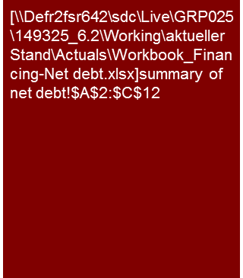
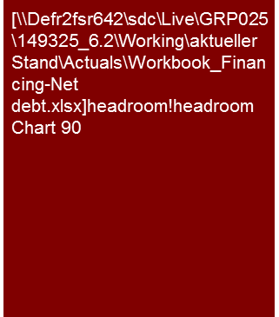
Overview
Historical Analysis of Financial Indebtedness/Net debt
Flag: The workbook contains sample net debt and balance sheet analysis in accordance to IFRS and German GAAP. Check your local GAAP requirements and accounting principles before applying the content.
Tools listed are commonly used in Germany and may differ in other regions.
Mission Statement:
Definition of financial net debt as bridge from enterprise value to equity value (purchase price) and analysis into existing financing headroom.
Customer situation
Definition/Methodology/Tools of the basis analysis
Buy Side/Sell Side/JV
Transition from enterprise to equity value (VAL, M&A and TS).
Leverage (debt to equity) to determine the WACC (VAL).
Definition of the balance sheet items to be treated as debt in the SPA and off-balance issues (TS).
Turnaround
Available lines of credit (including interest and repayment profile), amounts actually drawn and remaining headroom.
Definition and Methodology
Definition:
Net financial debt (in narrow sense) comprises cash and cash equivalents and interest bearing financial liabilities (e.g. bank overdraft, bank and shareholder loans, bonds, finance lease liabilities, factoring liabilities, etc.) and financial assets which can readily be converted to cash.
Debt-like items are (also off-balance sheet) items that will lead to a one-off cash in- or outflow post closing as opposed to working capital, which fluctuates more or less in line with business activities. The distinction between debt like and working capital requires professional judgement and hence is necessarily subjective.
Headroom describes available (unused) lines of credit (headroom plus cash = available liquidity);
Leverage (or gearing) (e.g. financial debt to EBITDA ratio) can be benchmarked and provides a good view on remaining borrowing capacity and potential financial stress.
Application and methodology:
Net debt in a wider sense (including debt like items): first and foremost used in the context of purchase price mechanisms;
In a multiple based valuation net debt provides the so called "equity bridge" from enterprise to equity value (purchase price).
A DCF valuation will consider debt-like items via the projected cash in- and outflows.
Net debt analysis requires a systematic review of on- and off-balance sheet items (plus capex backlog and similar issues)
Tools: Excel Workbook including bucket approach sample analysis and a list of potential net debt issues in sheet "debt like items"
Financial Debt only: relevant for DCF valuations (VAL)
Debt like items: frequently part of purchase price mechanism.
Headroom analysis
Degree of Standardization
List of typical debt-like items (Excel workbook).
"Bucket approach" (classification of all balance sheet items as net debt/WC/fixed assets/other.
List of loans (key terms of all loans).

Slide 4
Framework for balance sheet analysis and corresponding workbooks
Historical Analysis of Financial Indebtedness/Net debt
Challenge:
Linking the balance sheet analysis to cash flow (balance sheet movements) and P&L analysis (e.g. changes in provisions or inventory valuation → EBITDA adjustments).
Value/Price relevance of the balance sheet analysis
Profile of ”P&L" and "Cash Flow"
Enterprise value (e.g. EBIT x multiple)
Analysis tool - Bucket approach
Workbook "Financing - Net debt"
Direct impact on valuation: financial debt and debt-like items; fair value of pension and other financial liabilities/assets.
Other analyses (assessment of financial stability):
Headroom (available credit lines);
Borrowing profile (key terms and maturities),
Financial gearing, PPA issues
Workbook Provisions + Other Balance Sheet Items
Net (financial) debt
Direct impact on valuation: "Sorting" of other balance sheet items into debt-like (e.g. accrued interest in other payables) or working capital (e.g. provisions for outstanding invoices).
Other analyses
Understanding of cash flow and/or EBIT implications from movements in other balance sheet items;
"Completeness check" for net debt and WC analysis,
PPA issues
+/-
Workbook “Working Capital"
+/- working capital adjustment
Direct impact on valuation: working capital requirements (SPA: level and definition for target WC); drivers of future WC requirements (e.g. working capital days for financial model).
Other analyses (partially relevant for valuation/financing):
Seasonality (→ financing headroom required);
Special effects (impacts from the business model, accounting policies, factoring etc.) → if applicable consider in valuation;
valuation of inventory and debtors, PPA issues.
+/-
Workbook "Fixed assets - CAPEX"
+/-
other adjustments (e.g. Capex backlog)
Direct impact on valuation: Capex and maintenance require-ments (e.g. compared to depreciation, and capex or maintenance backlog)
Other analyses (understanding the business model):
Capacity and utilization, state of technology;
Manufacturing footprint / plant relocations
Fair value (PPA) and impairment issues
=
Equity value/ Purchase price

Slide 5
Pitfalls and lessons learned
Historical Analysis of Financial Indebtedness/Net debt
No. | Specific analysis
 | Missing reconciliation of net debt to balance sheet sub-totals: The more complex (”broader") net debt is defined, the greater the risk of confusion for the recipients of the report. Avoid of over-engineering, focus on the big tickets, and provide a reconciliation from net debt to the balance sheet (e.g. in the appendix): Balance-sheet line items only partially considered debt (e.g. accrued interest within other liabilities) → bucket approach; Valuation for net debt purposes differs from balance-sheet presentation, e.g. for bonds the balance sheet value has probably been reduced by issue/transaction costs (IAS39.43) whereas net debt analysis should use nominal or fair value, and in a transaction potentially debt breakage costs → reconciliation to balance sheet below the bucket approach; Off-balance sheet items (e.g. non-recourse factoring) → reconciliation to balance sheet below the bucket approach; debt-like items not quantified (e.g. contingent liabilities) → Sub-total before non-quantified items. Where possible use illustrative estimates to indicate potential magnitude of issue
 | SPA relevance: In the context of a transaction net debt frequently needs be contractually defined (e.g. SPA, covenants of loan agreements), but all too often there is a delay or gap in the communication between the deal negotiation team (usually lawyers) and the financial workstream. → seek this dialogue early and adapt your net debt presentation to your clients negotiation strategy (e.g. few adjustments to speed up the process versus claw back of headline price via broad net debt definition). To support negotiations, distinguish between undisputed debt items and a ”negotiating matter" and present these with separate sub-totals. A sample net debt calculation to be used at closing should be attached to the SPA (populated with historical and or projected figures to illustrate the calculation).
 | Double counting: For balance sheet items classified as net debt, the corresponding P&L effects shall be shown below EBIT. Examples: Pension provisions as debt → pension interest expenses below EBIT; fair value of commodity hedges as debt → valuation-relevant planning to be based on un-hedged commodity prices; factoring as debt → factoring fees below EBIT (but fees for debtor accounting and dunning above EBIT).
 | Potential liquidity and financing bottlenecks are not detected (especially FDD): If our analysis is focused on historical year end balance sheets only, there is the risk that we will not identify impending liquidity and/or financing bottlenecks. Headroom analyses and debt maturity profiles can help to avoid this.
 | Missing reconciliation of net debt to interest expenses: As a sense check of your net debt figure, seek to match debt times interest rate to reported interest expenses in the P&L. This simple 'test' can significantly enhance the understanding of the company's financing and respective interest rates applicable for different financing instruments are a good indicator for potentially significant differences between fair value and nominal amounts (and carrying value in the balance sheet).
1
2
3
4
5

Slide 6
Core issue (1/2)
Historical Analysis of Financial Indebtedness/Net debt
Core Issue | Specific analysis | Page(s)
What is the level and the composition of net debt on effective date or closing? How robust (“hard” or “soft” adjustments) are the identified debt like items? | Determination of level of net debt is essential for the calculation of equity coming from enterprise value. In acquisitions the purchasing price is adjusted for changes between effective date and closing. Exact definition of net debt is essential for SPA purposes (consideration of debt-like items?) Identification of interest-bearing items and classification of balance sheet items (bucket approach and "checklists"). Identification and analysis of off-balance sheet financing instruments (e.g. factoring, leasing, etc.). Development of net debt and debt ratio over time. Analysis of accounting and valuation principles as well as check if interest rates are in line with market rates Determination of market value of debt elements Determination of debt ratio (if necessary, industry comparison). | 8-9, 12
2. Does the fair market value of financial debt differ (significantly) from its book value (e.g. for pensions; loans and bonds carried at amortized cost, etc.)? | Analysis of accounting valuation versus market value | n/a
3. Is there sufficient headroom (available lines of credit) and/or room for additional borrowing and how much (potential debt collateral not yet pledged; debt to EBITDA ratio; compliance with debt covenants). | Headroom analysis Borrowing profile (with key terms and maturities) Benchmarking of financial gearing | 9,10
360° CQ

Slide 7
Core issue (2/2)
Historical Analysis of Financial Indebtedness/Net debt
Core Issue | Specific analysis | Page(s)
4. To what extent are financing elements such as leasing and factoring already used (incl. sale & leaseback, ABS structures, etc.) and how has this impacted the balance sheet and the P&L? | Analysis of financing instruments applied and respective balance sheet and P&L implications Benchmarking versus peers (e.g. percentage of leased versus own fleet for airlines, shipping or trucking companies) | n/a
5. Is short and mid-term liquidity sufficient for the business (to cover monthly or intra-month working capital fluctuation, capex and other significant payments)? | Analyses under 3.) above combined with analysis of: Historical seasonality of liquidity; and Specific capital/financing requirements in the business plan | 9
6. Are there constraints regarding the future development from the existing financing structure (e.g. covenants, change of control clauses, larger credit payments due). | (Detailed) borrowing profile (with key terms and maturities) Potential covenants preventing the payment of dividends post acquisition | 10

Slide 8
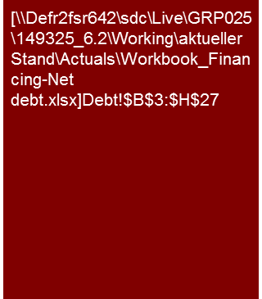
Sample net debt analysis (1/2) – Amount and definition of net debt
Historical Analysis of Financial Indebtedness/Net debt
Net financial debt per December '15 was €1.8 million (after “Net Cash” position in prior years).
Additional debt-like items identified in the balance sheet increase net debt by only €0.1 million.
The most important off balance sheet item to be considered when forming a view on financing requirements are bank bonds of €2.8 million.
As shown in Appendix XX.1 credit lines are with one bank only and will expire soon. Management is currently negotiating prolongation, but has not presented alternative solutions to avoid insolvency should these negotiations fail.
Net financial debt
Net financial debt position increased following the focus on the stationary installations business as these have longer completion times and higher financing requirements than the ABC business.
Currently, two credit lines are in place at XXX bank with an amount of €3.5 million , respectively €4.65 (earmarked for project financing). At 31 December 2015, an amount of 2.5 million was utilized. Both facilities expire at the end of September 2016. Prolongation of the contracts is currently negotiated with XXX bank and management expects continuation. An overview of bank loans is presented in appendix 8.
Management indicated that there is currently limited intra-year headroom in credit lines. Details in respect of historical credit line availabilities and headroom are outstanding.
Debt- like items
Receivables from affiliated companies relate to loan receivables from shareholders and dividends outstanding from subsidiaries. Information with regard to the recoverability of such receivables is outstanding. We regard these financial receivables as a reduction to net dent.
Liabilities to affiliated companies relate to financing and we thus regard these debt-like.
Tax accruals are income tax related and as such are payable by a potential purchaser unless the Seller provides coverage through tax indemnity.
The provision for severance pay at year end 2015 was recorded in the context of redundancies as part of a social plan. The compensation has been contractually agreed and represents a certain cash outflow.
Source: Annual reports 2010 and 2011; Draft annual report 2012; management information; KPMG analysis
To be discussed what level of debt to EBITDA banks are willing to accept.
Note: With a debt/EBITDA ratio > 3-3.5 it is recommended to consult the Debt Advisory Team in Corporate Finance M&A

Slide 9
Sample net debt analysis (2/2) – Amount and definition of net debt
Historical Analysis of Financial Indebtedness/Net debt
[Note: The core issue "How high is the net debt on the effective date and how is it comprised?” is answered with the tabular presentation. The description of the individual items can seldom be summarized in a core statement; it is, however, depending on the customer situation, important especially for the SPA negotiating team, but also for the corresponding balance sheet planning.
Whether only especially significant debt items are commented on or even the entire description is shifted to the appendix depends on the customer's wishes.]
Other items consideration
The credit lines at XXX bank are pledged with a time deposit of €250,000. As such, this balance represents trapped cash and reduces available liquidity. However, in our view it does not increase net debt, as from a commercial point of view it would also reduce the outstanding bank loan amount.
Bank bonds as per 31 December 2015 include performance bonds, warranty bonds and advance payment bonds, which are required by many large customers. The provision of bid bonds for tenders was required only once in the past. For an overview on outstanding bank bonds as per 12 September 2016 please refer to Appendix XXX. As these bank bonds reduce the available credit line (same as a loan), they need to be considered when forming a view on net debt and required financing. However, if Target does not default under its customer contracts, these bonds will not lead to a cash outflow (unlike a bank loan).
Advance payments received from customers generally need to be supported with bank bonds. XXX bank requires 20% cash collateral to be provided for respective bank bonds (for advance payment bonds only). Such balances represent trapped cash. From the overview of bank bonds as per 12 September 2016 (see Appendix XXX) we understand that such amounts are minor, as total outstanding advance payment guarantees were €13,500 only.
Future lease commitments largely relate to vehicles and machinery. An amount of €203,000 is due in 2013, and a cumulative amount of €321,000 in the years 2017 to 2020. The significant reduction of liabilities from 2013 to 2014 reflects the acquisition of the premises in XXX which were previously rented. Accounting for these leases as finance leases would result in a lease liability which could be considered debt. However, in that case lease expenses would then be “moved to below EBITDA”.
Litigation risk primarily relates to the dispute with customer XXX. In February 2016, the company initiated legal proceedings against XXX. The subject matter is the collection of two installations produced (still stored on site) and invoiced in 2017 for an offshore wind power generator, as well as the payment of the residual receivable of €74,000. Both was refused by XXX, claiming deficiency of the installations. In March 2016, XXX claimed withdrawal from the contract (total value: €1.476,000) and reimbursement of instalments already paid (€1.402,000). According to management the deficiency claims merely represent an pretext for the non-acceptance of the two installations, as the related offshore project was not completed and the installations are no longer needed. A provision for related risks was not recorded and receivables were not written-down in the annual accounts for 2015. The auditor concurs with management’s risk assessment of the issue as remote. The exposure could also be covered by an indemnity offered by the Seller. The amount presented in the net debt overview represents a maximum risk.
The company has provided guarantees for the securitization of loans drawn by a subsidiary. We understand from discussion with management that all such guarantees have been replaced or cancelled by the end of August 2016.

Slide 10
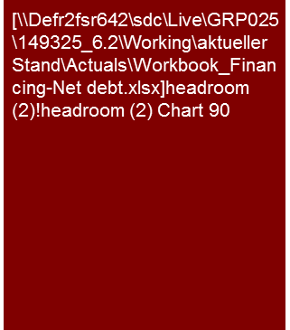
Sample analysis – Headroom/current liquidity
Historical Analysis of Financial Indebtedness/Net debt
Weekly liquidity reporting shows increasing headroom in credit lines for the remainder of the year due to forecast proceeds for large projects.
Partial deliveries for these projects reduced peak financing requirements in 2016.
Data presented here is based on an internal reporting tool, hence accuracy of data may be limited.
However, it clearly shows:
Significant intra year fluctuations of net debt;
Available headroom was only €0.5 million in CW 17;
Liquidity is expected to improve towards year end.
Liquidity by calendar week 2016
Headroom analysis
Additional bank bonds required reduce available credit line for borrowings
Old bank bonds expired and freed up available credit line for borrowings.
Total available credit lines of €8.15 million are reduced by bank bonds of between €2.6 to 3.7 million.
Actual Jan – August 2016
Forecast Sept – Dec 2016
Minimum headroom: €0.5 million.
Cash receipts for large projects expected to result in net debt becoming a positive (cash balance)
Source: Management information, KPMG analysis
For alternative headroom presentation see also "Cash Management" workbook .

Slide 11
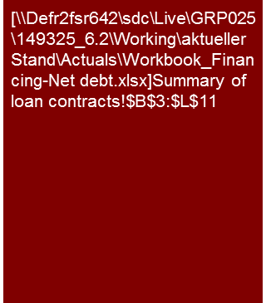
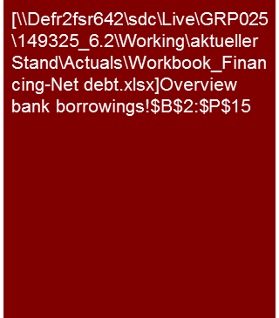
Sample analysis – Level of loans (Appendix XX.1)
Historical Analysis of Financial Indebtedness/Net debt
Prolongation of the facilities is currently being negotiated.

Slide 12
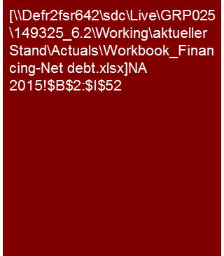
Sample analysis – Bucket approach
Historical Analysis of Financial Indebtedness/Net debt
This example refers to holdings in affiliated companies.
Pure financial investments may , of course, be classified as financial debt.
Source: Annual reports 2010 and 2011; Draft annual report 2012., management information, KPMG analysis

Slide 13
High-level view of net debt – Corporate finance
”Debt Capacity" based on Net debt / EBITDA ratio analysis is an important issue for C level discussions
The only item typically considered as debt-like in such high level discussion are pension liabilities (and even these are more an issue for analysts / rating agencies than for banks)
On such simplified basis it is possible to simulate the impact of potential acquisitions or divestments of portfolio companies on the debt rating of an entity.
Due diligence obviously has to analyze net debt in more granularity, but sometimes such high level view may help to put findings into perspective (especially when too detailed analyses makes it difficult to come up with key findings)
Financing/Headroom
4
Holdings portfolio in market test/capital requirements
5
A. Rating view
B. Bank view
Adj. Net Debt 2012
Net debt 2012 - w/o pensions and asset retirement obligations -
Maintain single A- Rating
Target leverage of 3.0x
Liquidity ensured through unutilized lines of credit
Rating view shows necessity of reducing leverage
Additional headroom (~€Xmillion) potential from bank view
Need to improve underlying EBITDA in order to create further headroom
Consider headroom implications from divestments
high
x
x
€X bn
Potential net debt with target leverage
€X bn
€X bn
3x Net Debt/ EBITDA
x
X
Leverage 3,59x Net Debt/ EBITDA
Saleability
x
€X bn
x
x
Leverage 1,8x
x
x
€X bn
€X bn
x
x
x
Hungary
x
low
Adj. EBITDA 2012
Adj. EBITDA 2012
Possible Headroom
low
Full consolidation
Future capital requirements
high
At Equity / Cost
Size of circle symbolizes profit contribution
Option x
Option x
B
C
Indicative valuation (percentage)
Market estimation
x
Headroom impact (indicative)*
Target currently with little leverage, but full consolidation – supports X-Headroom
Ambitious CAPEX-planning will increase leverage (€ x billion by 2020)
Headroom-effect with divestments ca.. €x million
Purchase price: €x million
Net debt effect: - €x million
EBITDA effect: - €x million
Construction of new x will increase net debt of X by ca. €x million
Indicative valuation (share)
Market estimation
x
x
x
Headroom impact (indicative)*
At equity accounting
Headroom-effect with divestment: rd. €150-350 million
Purchase price: €x-x million
Net Debt effect: €0 million
EBITDA effect: - €x million
Consider potential impairments of investments
x- x
CoTrans
x– x
(2010
-
2012)
EBITDA
CoTrans
CoTrans
(2010
-
2012)
(2010
-
2012)
EBIT
EBITDA
400
600
800
200
300
400
500
600
Pro rata equity value
Pro rata equity value
(
€
m)
(
€
m)
Potential investors
x
x
x
Potential investors
x
x
x

Slide 14
© 2017 KPMG International Cooperative (“KPMG International”). KPMG International provides no client services and is a Swiss entity with which the independent member firms of the KPMG network are affiliated.

